Slide 1
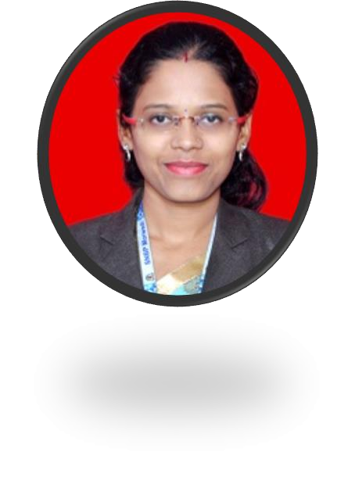

Kirti Ashok Mandlik
Education and certificates Master of Engineering Computer: 2020
Skills
Analyst/Software Engineer
C# | Basics, OOPS, Exception Handling, ,Collections & Generics, Delegates, Events, File IO and Serialization
.NET | ADO.NET, LINQ, Entity Framework, Sql Server, ASP.NET MVC5 with WEB API
ADO.NET | Basics, Connected and Disconnected Architecture
Software Testing | Manual Testing and Automation testing using JAVA
RDBMS | Basic And Advanced Using SQL Server.
Python | Basics, OOPS, Modules like NumPy
Add On Skills | Communication, Team management
UI Technology Angular | HTML5, CSS3, JavaScript, ES6 & Type Script Components, Services, Modules, Routing, Forms & Validation
Tools | GIT, Postman, IDE
Base Location: Mumbai
Email ID: kirti.mandlik@capgemini.com
Mobile No: +91 7620376508
Grade: A4
Strengths
Full Stack Developer
Practical understanding of RDBMS concepts using
Oracle and SQL Server.
Achievement
Online Crop Deal Management System Completed case study on CropDeal Management System along with API getway, Swagger, Responsive UI with HTML5, CSS, Bootstrap and Angular used as a Interface.
Video Link: https://screenrec.com/share/1IPtNVA9Xz
Hands on experience on C#, ADO.NET, LINQ, Entity Framework, Sql Server, ASP.NET MVC5 with WEB API
Proficient in creating Single Page Page Application in
Angular with Authentication with routing
Understanding of HTML 5 and CSS and Angular CLI
Completed soft skill courses on Coursera: Successful Presentations, Write Professional Emails, Communication
Completed Microsoft AZ-900 certification
Completed Microsoft AZ-104 certification
Strategies for Virtual Age
Completed Agile Software Development Certification
https://github.com/kirtimandlik

